Slide 1
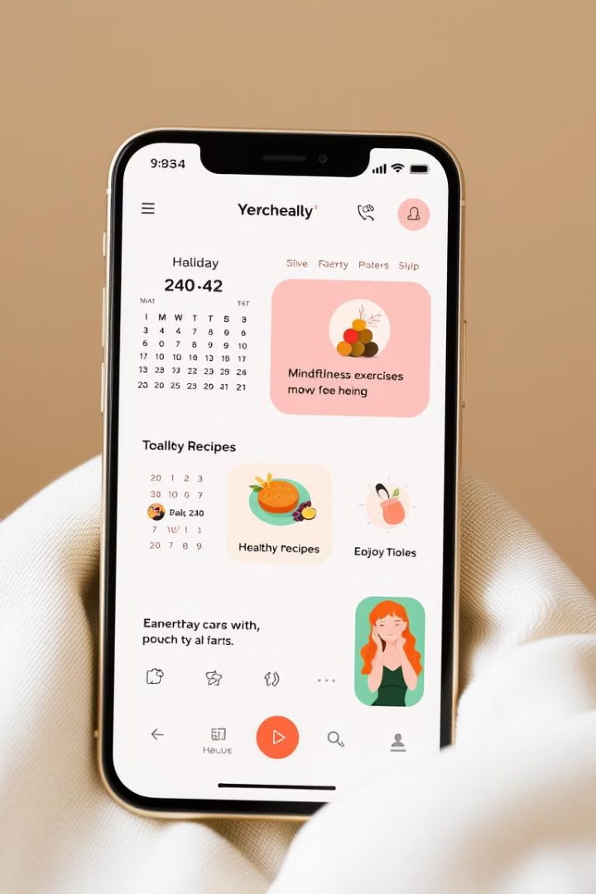
Health and Wellness App
J. SAHITHI
192211980
Page no:1

Slide 2

INTRODUCTION:
A health and wellness app is a mobile or web-based platform designed to promote and enhance an individual's well-being by offering tools for tracking physical activity, managing nutrition, monitoring mental health, and setting personal goals. In today's fast-paced world, maintaining a healthy lifestyle can be challenging, and such apps provide users with convenient access to fitness resources, dietary recommendations, mindfulness practices, and health-related metrics all in one place. These apps are becoming increasingly popular as people look for ways to stay healthy, manage stress, and achieve a balanced lifestyle, often from the convenience of their smartphones.
Page no:2

Slide 3

Project Objective
This project aims to develop a comprehensive health and wellness app that empowers users to make informed choices for a healthier lifestyle.
Personalized Tracking
Educational Resources
Provide users with tailored tracking features for various health metrics, such as fitness activities, sleep patterns, and dietary intake.
Offer access to a wealth of reliable information on health topics, including fitness routines, healthy recipes, and stress management techniques.
Community Support
Professional Guidance
Foster a supportive community where users can connect, share experiences, and motivate each other on their health journeys.
Enable users to connect with qualified health professionals for personalized advice and support.

Slide 4
Existing Systems and Drawbacks
Existing health and wellness apps often lack user-friendly interfaces, comprehensive features, and personalized guidance, leading to low engagement and user dissatisfaction.
Limited Personalization
Inconsistent Data Integration
Lack of Professional Guidance
Many apps offer generic plans and lack the ability to tailor recommendations based on individual needs and goals.
Data from various fitness trackers and devices may not integrate seamlessly, hindering a holistic view of user health.
Many apps lack features for connecting with qualified health professionals for personalized advice and support.
Page no:4

Slide 5

Proposed System and Advantages
Our proposed health and wellness app addresses the shortcomings of existing systems by providing a personalized, comprehensive, and user-friendly experience.
1
Seamless Data Integration
2
Personalized Recommendations
The app seamlessly integrates with popular fitness trackers and devices, providing a unified view of user health data.
Based on user preferences, goals, and tracked data, the app provides tailored recommendations for fitness routines, nutrition plans, and stress management strategies.
3
Expert Guidance
4
Engaging Gamification
The app offers features for connecting with qualified health professionals, allowing users to access personalized advice and support.
The app incorporates gamification elements to enhance user engagement and motivation, encouraging users to consistently track their progress and achieve their goals.
Page no:5

Slide 6
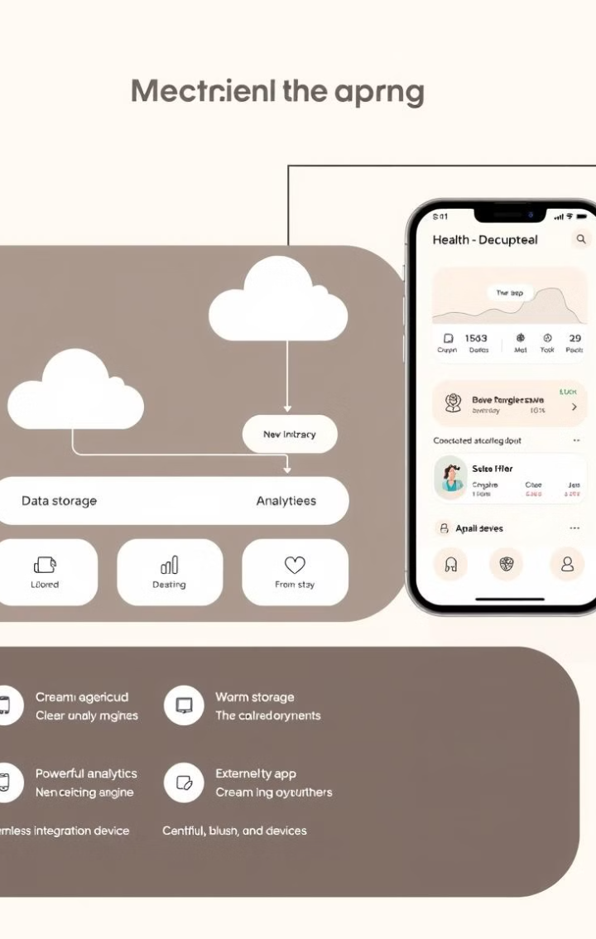
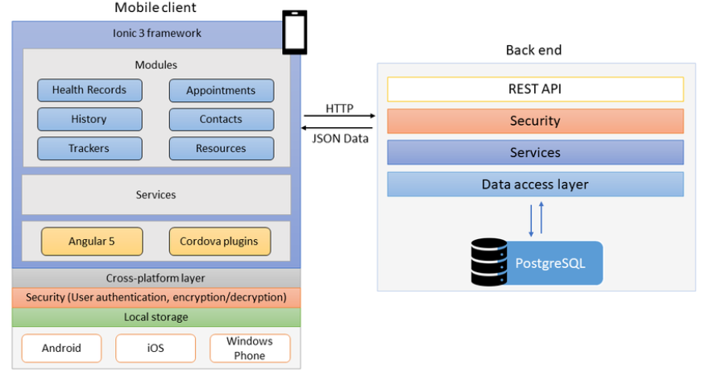
Architecture Diagram
The architecture diagram illustrates the key components of the proposed system, including the user interface, backend server, data storage, and integration with external services.

Slide 7
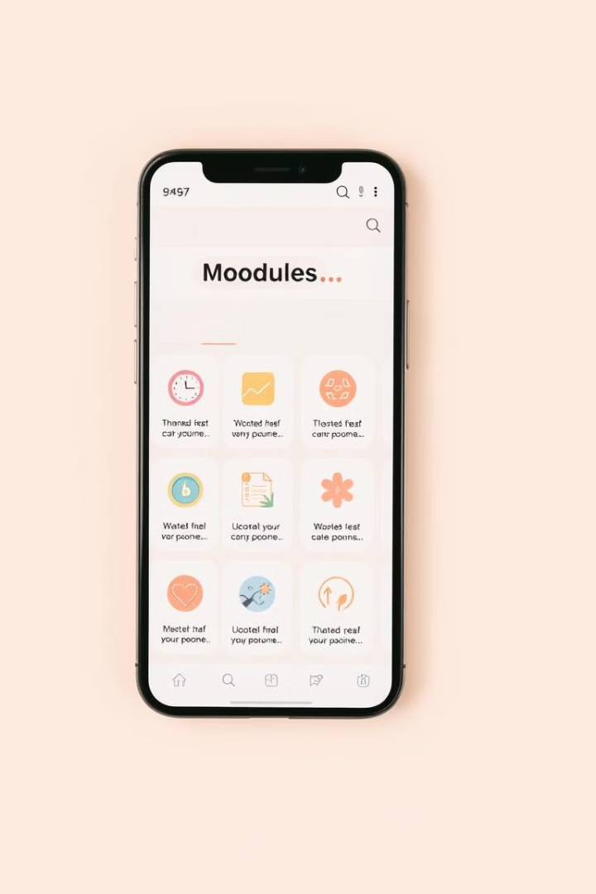
Modules
The app is designed with distinct modules that cater to different aspects of health and wellness, ensuring a comprehensive and user-friendly experience.
User Profile
Fitness Tracker
Nutrition Tracker
Mental Health
Sleep Monitoring
Community Forum
Health Professionals
Data Analytics
Settings
Page no:7

Slide 8





Conclusion and Future Enhancements
The proposed health and wellness app offers a comprehensive and user-friendly platform for promoting a healthier lifestyle.
Cloud Integration
AI-Powered Insights
Virtual Reality Experiences
Wearable Device Integration
Seamlessly integrate with cloud services for enhanced data storage, backup, and accessibility.
Leverage AI algorithms to provide personalized insights, predict health trends, and offer proactive guidance.
Explore the potential of VR for immersive fitness experiences, mindfulness exercises, and educational content.
Integrate with a wider range of wearable devices to capture a broader range of health data.
Page no:8

Slide 9


